Slide 1
Predictive Maintenance of Industrial Machinery
CAPSTONE PROJECT
Presented By:
Shruti Suresh Gaikwad – Vivekanand Arts, Sardar Dalipsingh Commerce and Science College – Computer Science

Slide 2
OUTLINE
Problem Statement
Proposed System/Solution
System Development Approach (Technology Used)
Algorithm & Deployment
Result (Output Image)
Conclusion
Future Scope
References

Slide 3
Problem Statement
In modern manufacturing industries, machinery breakdowns lead to significant production losses, increased maintenance costs, and unexpected downtime.
Traditionally, maintenance is either reactive (after a failure) or scheduled (based on usage), both of which are inefficient.
The challenge is to develop a system that can predict potential machine failures in advance using real-time sensor data such as temperature, torque, speed, and tool wear.
Accurately predicting the type of failure before it occurs can enable industries to shift toward predictive maintenance, improving operational efficiency and reducing unplanned outages.

Slide 4
Proposed Solution
The proposed system aims to address the challenge of predicting the type of failure in industrial machines before it occurs. This enables industries to move from reactive or scheduled maintenance to predictive maintenance, reducing unplanned downtime and optimizing operational efficiency. The solution will consist of the following components:
Data Collection :
Gather historical sensor data from industrial machinery, including : Air temperature, Process temperature, Rotational speed, Torque, Tool wear, Product type
The target column is the Failure Type, which includes various failure categories (e.g., Tool Wear, Overstrain, Power Failure, etc.).
Data Preprocessing :
Clean and preprocess the dataset by :
Removing irrelevant columns (UID, Product ID)
Handling missing values
Ensuring categorical data like Type is encoded properly
Analyze class imbalance and prepare data for model training.
Machine Learning Algorithm :
Implement a Supervised Machine Learning algorithm using Watsonx.ai AutoAI, which automatically:
Selects the best classification algorithm
Trains the model on historical sensor data
Evaluates multiple pipelines based on accuracy
Multi-class classification is used to predict the specific type of failure

Slide 5
Proposed Solution
Deployment :
The best model from Auto AI is:
Promoted to a Deployment Space
Deployed as an online prediction service using IBM Watsonx.ai
This enables real-time prediction of failure types from new input data.
Evaluation :
Model performance is evaluated using metrics like:
Accuracy
Precision
Recall
Confusion Matrix
Predictions are tested using sample machine data to verify accuracy

Slide 6
System Approach
The "System Approach" section outlines the overall strategy and tools used to develop and implement the predictive maintenance system using machine learning on IBM Cloud. Here's a suggested structure for this section:
System requirements :
Minimum 4 GB RAM
Intel i3 Processor or above
Stable Internet Connection
Web browser (Chrome/Edge) to access IBM Cloud
Library required to build the model :
IBM Cloud Lite Account
Watsonx.ai Studio
Cloud Object Storage (Free plan)

Slide 7
Algorithm & Deployment
Algorithm Selection :
The algorithm was selected using Watsonx.ai AutoAI, which automatically compares multiple classification algorithms.
The best-performing algorithm chosen was Decision Tree Classifier, as it handles multi-class classification effectively and works well with tabular sensor data.
Random Forest is robust to overfitting and performs well even when data is slightly imbalanced.
Data Input:
Input features used to train the model :
Type (L, M, H)
Air temperature [K]
Process temperature [K]
Rotational speed [rpm]
Torque [Nm]
Tool wear [min]
Target variable :
Failure Type (Includes: No Failure, Tool Wear Failure, Power Failure, etc.)

Slide 8
Algorithm & Deployment
Training Process:
The dataset was uploaded to Watsonx.ai AutoAI.
AutoAI :
Automatically handled preprocessing and feature engineering.
Trained multiple models using techniques like cross-validation.
Evaluated models based on accuracy and precision.
The top-ranked model was saved and promoted for deployment.
Prediction Process:
After deployment, the model receives real-time machine sensor data.
Based on the input, it predicts the type of failure that might occur.
This helps in taking preventive action before the actual failure happens.
Deployment :
The selected model was:
Promoted to a Deployment Space on IBM Cloud.
Deployed as an Online Web Service using Watsonx.ai.
Users can test the deployed model by sending new machine data and getting predicted failure types instantly.

Slide 9
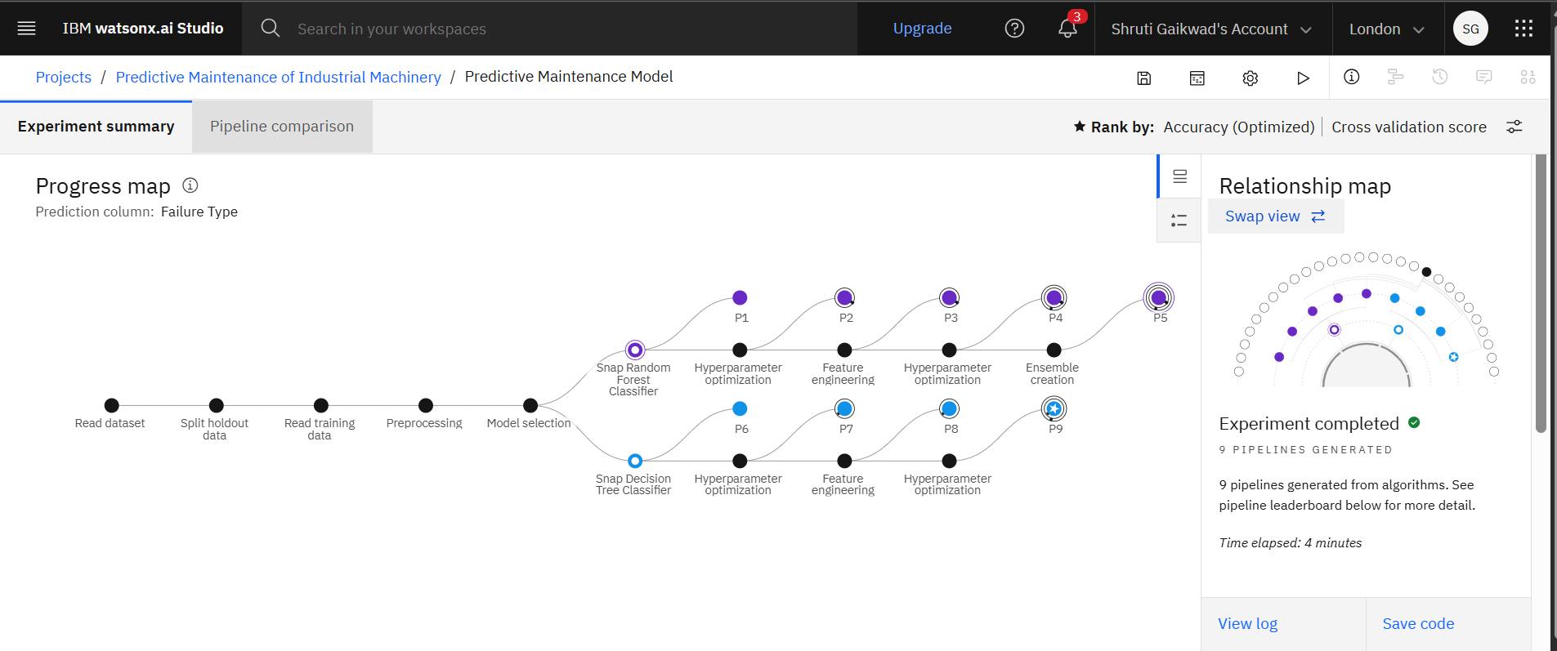
Result

Slide 10
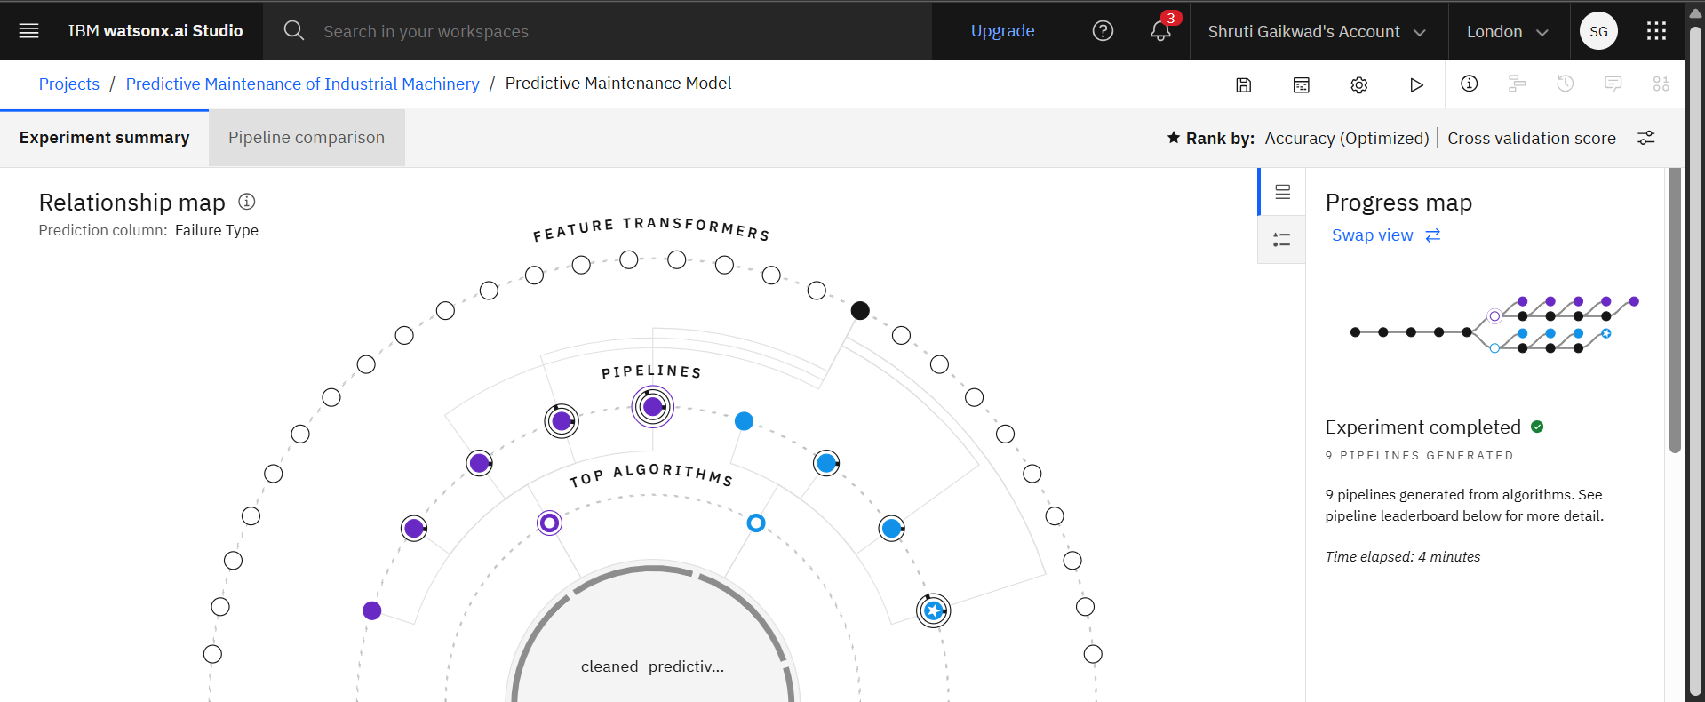
Result

Slide 11
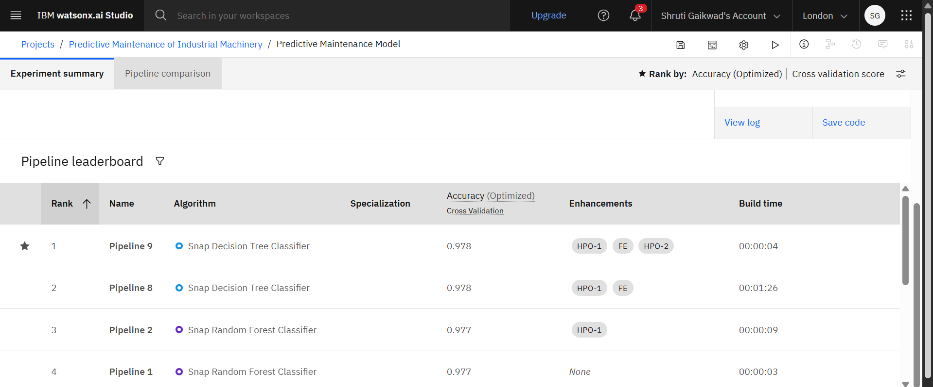
Result

Slide 12
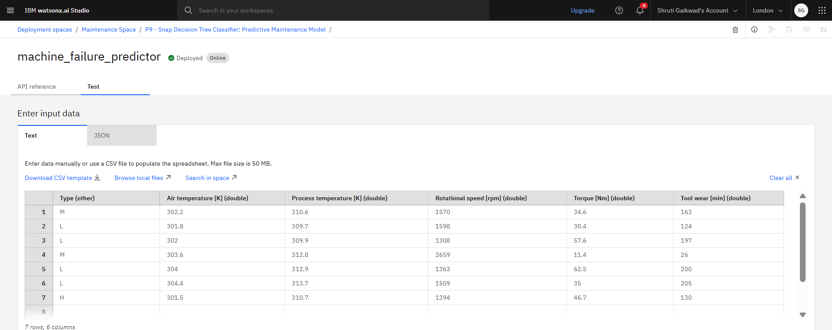
Result

Slide 13
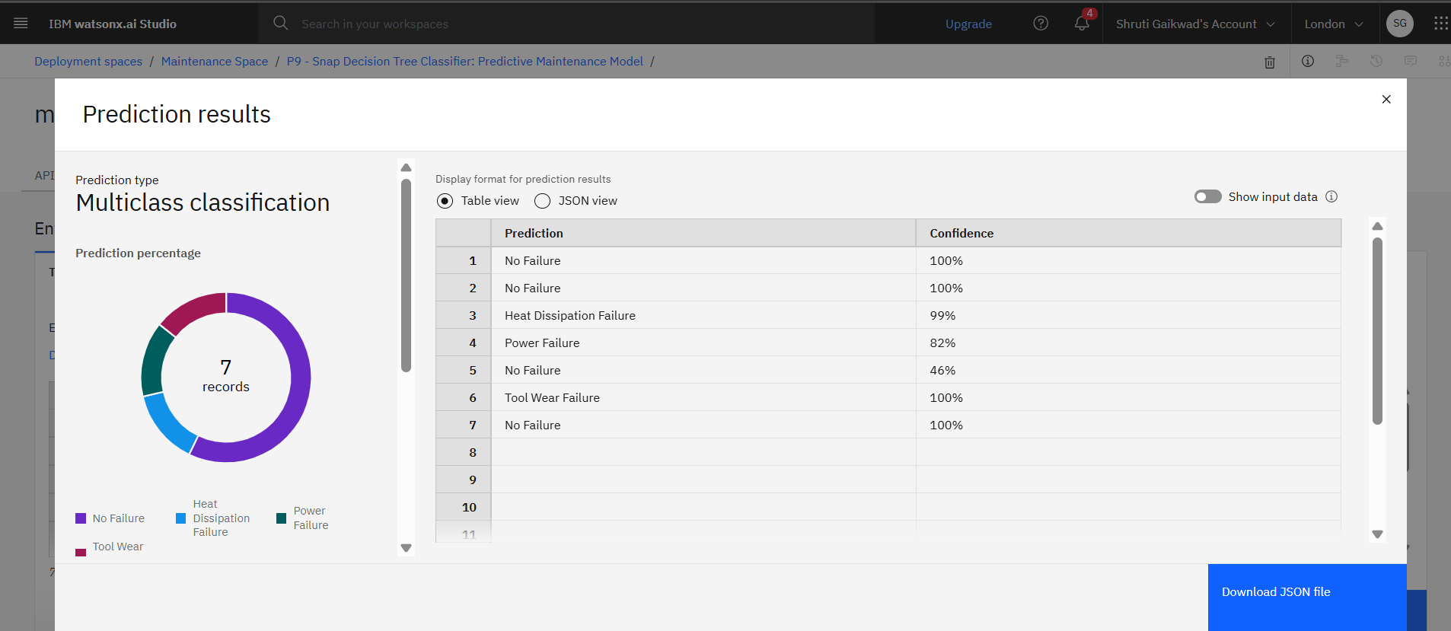
Result

Slide 14
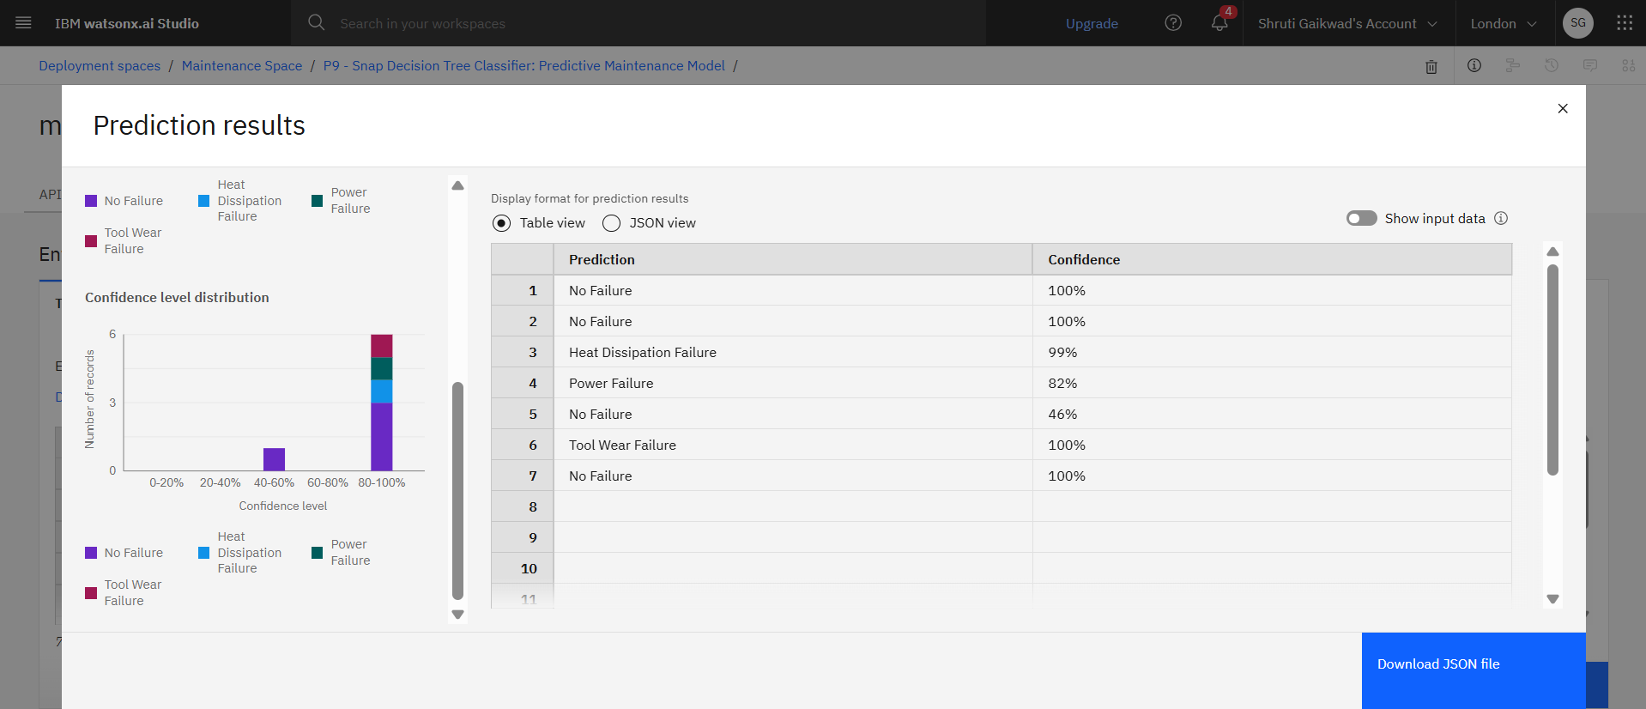
Result

Slide 15
Conclusion
The project successfully developed a supervised machine learning model to predict the type of failure in industrial machines using real-time sensor data. By leveraging IBM Watsonx.ai's AutoAI, the system automatically selected the best-performing model, enabling accurate classification of failures such as tool wear, power failure, and overstrain. This solution helps industries move toward predictive maintenance, reducing unexpected downtime and maintenance costs. During implementation, challenges like class imbalance and sensor data interpretation were addressed. The project demonstrates the effectiveness of machine learning in improving industrial efficiency, with potential for future enhancements like real-time IoT integration and expanded failure categories.

Slide 16
Future scope
Integrate real-time IoT sensor data to enable live failure prediction and faster decision-making.
Expand the system to include more sensor types, such as vibration, sound, oil quality, and machine usage history.
Use advanced machine learning techniques like deep learning or ensemble models to improve prediction accuracy.
Implement edge computing for on-site prediction without relying solely on cloud infrastructure.
Extend the system to work with different types of industrial machines across various sectors (e.g., automotive, manufacturing, power plants).
Enable dashboard-based monitoring tools for maintenance teams to visualize failure trends and model predictions.
Regularly update the model with new failure cases to keep improving accuracy over time.

Slide 17
References
Kaggle Dataset – https://www.kaggle.com/datasets/shivamb/machine-predictive-maintenance-classification
IBM Cloud Lite – https://cloud.ibm.com
IBM Watsonx.ai Documentation – https://www.ibm.com/cloud/watsonx-ai

Slide 18
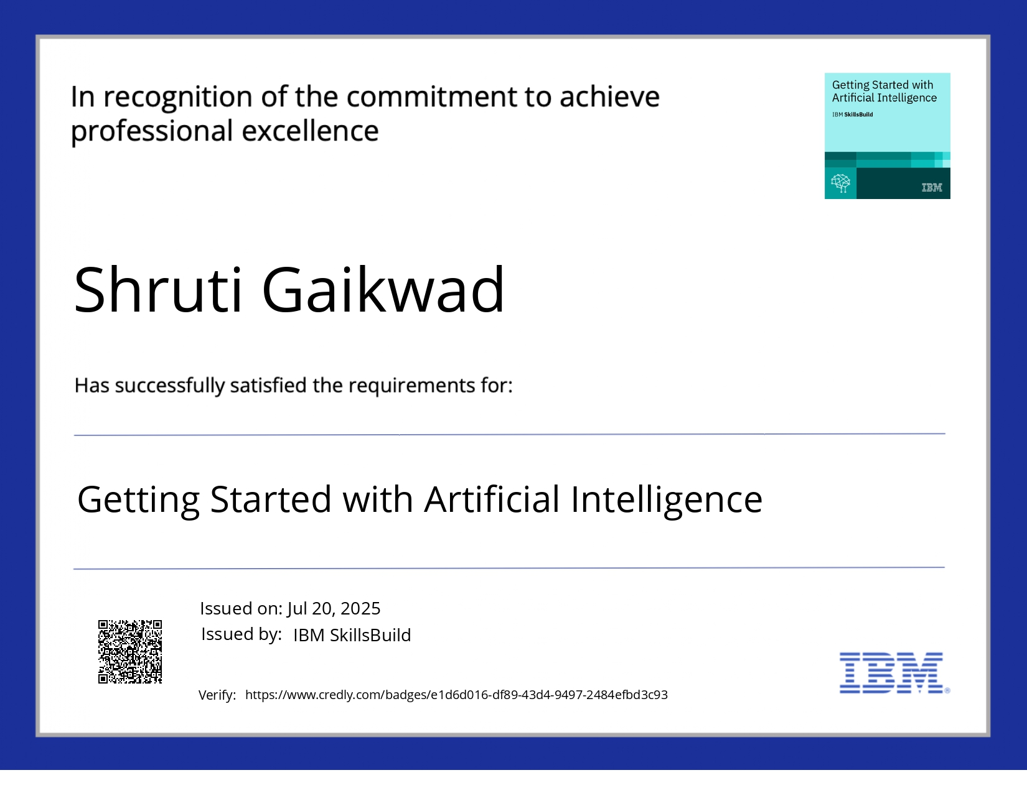
IBM Certifications

Slide 19
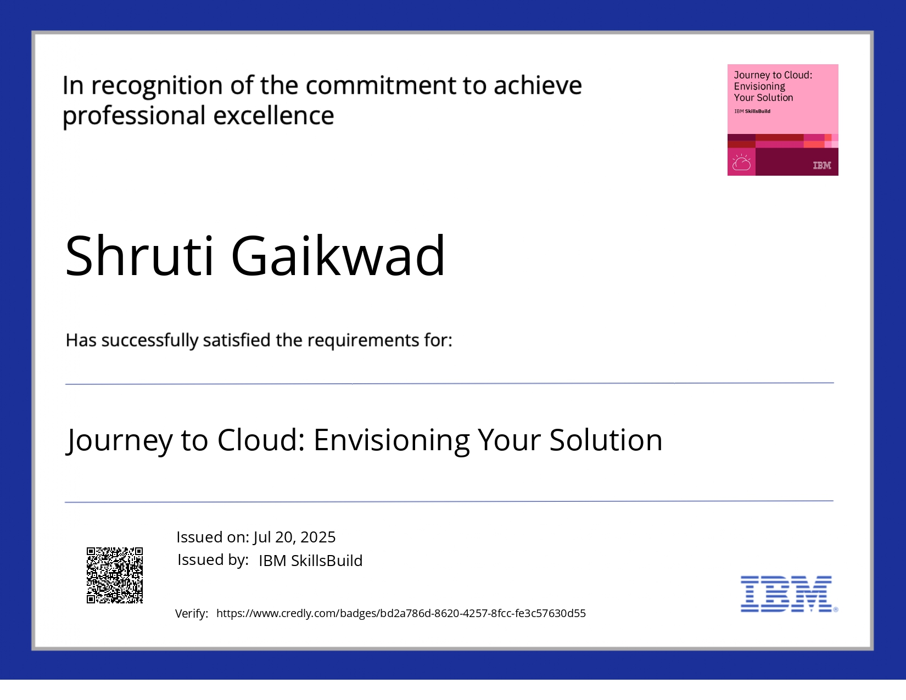
IBM Certifications

Slide 20
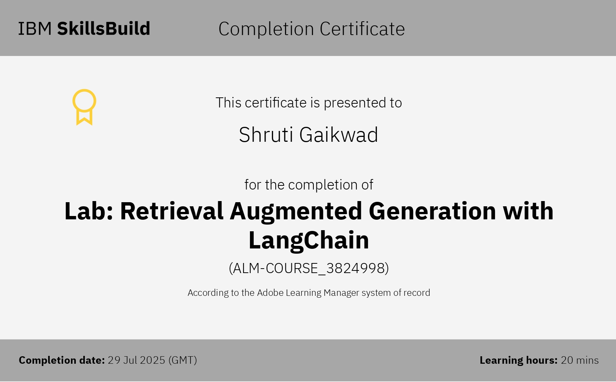
IBM Certifications

Slide 21
THANK YOU

